Slide 1
Performance Analysis of Algorithms

Slide 2
An algorithms is a sequence of steps to solve a particular problem.
One problem can have ‘n’ number of solutions. (i.e., multiple solutions).
To find out best solution among ‘n’ solutions, we apply some analysis.
Analysis of algorithms is the determination of the amount of time and space resources required to execute it.

Slide 3
The performance of an algorithm can be measured by two properties: Time & Space
Time complexity of an algorithm quantifies the amount of time taken by an algorithm to run as a function of the length of the input.
Similarly, Space complexity of an algorithm quantifies the amount of space or memory taken by an algorithm to run as a function of the length of the input.

Slide 4
In fact, Time and space complexity depends on lots of things like hardware, operating system, processors, etc.
- However, we don't consider any of these factors while analysing the algorithm. We will only consider the execution time of an algorithm.
Efficiency can be measured at two different stages, before implementation and after implementation, as
A priori analysis − This is defined as theoretical analysis of an algorithm. Efficiency of algorithm is measured by assuming that all other factors e.g. speed of processor, are constant and have no effect on implementation.
A posterior analysis − This is defined as empirical analysis of an algorithm. The chosen algorithm is implemented using programming language. Next the chosen algorithm is executed on target computer machine. In this analysis, actual statistics like running time and space needed are collected.

Slide 5
Space Complexity: an algorithm represents the amount of memory space needed the algorithm in its life cycle.
Space needed by an algorithm is equal to the sum of the following two components:
Space S(p) = Fixed part (A) + Variable Part Sp(I)
A fixed part that is a space required to store certain data and variables (i.e. simple variables and constants, program size etc.), that are not dependent of the size of the problem.
A variable part is a space required by variables, whose size is totally dependent on the size of the problem.
For example, recursion stack space, dynamic memory allocation etc.

Slide 6
In other words…….
Space can be calculated based on amount of space required
To store program instructions.
To store constant values.
To store variable values.
And for few other things like function calls, jumping statements etc.,

Slide 7
Ex-1:
int sum(int A[ ], int n)
{
int sum = 0, i;
for(i = 0; i < n; i++)
sum = sum + A[i];
return sum;
}
In the above piece of code it requires - 'n*4' bytes of memory to store array variable 'a[ ]' - 4 bytes of memory for integer parameter 'n' - 8 bytes of memory for local integer variables 'sum' and 'i' (4 bytes each) - 4 bytes of memory for return value.

Slide 8
In case of Time complexity, the running time of an algorithm depends upon the following...
Whether it is running on Single processor machine or Multi processor machine.
Whether it is a 32 bit machine or 64 bit machine.
Read and Write speed of the machine.
The amount of time required by an algorithm to perform Arithmetic operations, logical operations, return value and assignment operations etc.,
- Input data

Slide 9
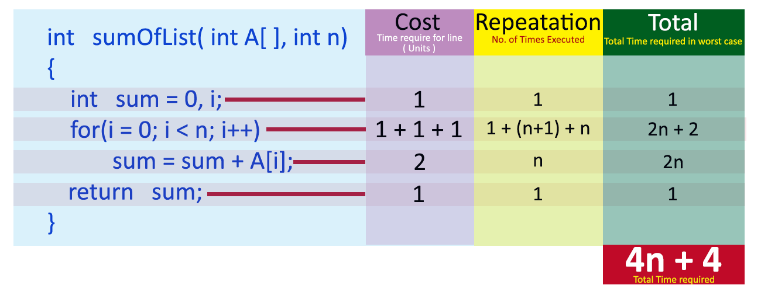
Ex-1:
int sum(int a, int b)
{
return a+b;
}
Here, there are 2 Statements:
Calculating a+b → 1 Unit
Returning a+b. → 1 Unit
Total 2 Units
Ex-2:
1
1+3n
1
---------
3n+3 units of time

Slide 10
O(N+N): 2n
for (i=0; i < N; i++)
{ print(a) }
for (j=0; j < N; j++)
{ print(b) }
(1+3n) + (1+3n) = 6n+2
O(N*N): n^2
for (i=0; i < N; i++)
{
for (j=0; j < N; j++)
{ print(b) }
}

Slide 11
Ex-3: For (i=1;i<=n; i++)
System.out.println(i);
3n+1
Ex-4: For (i=1;i<=n; i++)
System.out.println(i);
for(j=1;j<=m;j++)
System.out.println(j);
(3n+1) + (3m+1) ➔ 3m+3n+2
Ex-5:
for (i=1;i<=n; i++)
{ for(j=1;j<=n;j++)
System.out.println(j);
}
For Internal loop → (3n+1)
For the whole expression :
→ 1+ 2n * (3n+1)
6n² + 2n+1

Slide 12
Suppose a sample code with the equation:
10n² + 100n+1000 = n^2 units
n=1 ➔ 10+100+1000 →1110 units of time
n=2 ➔ 40+200+1000 → 1240
n=5 ➔ 250+500+1000 → 1750
n=10 ➔ 10 x 100 + 100 x 10 + 1000 → 3000
n=100 ➔ 10 x 10000 + 100 x 100 + 1000 →
Ignore, the constants in the expression -→ 10n² + 100n
In case of N = 1000, The second component may be ignored…..
10* n^{2 ➔ Ignore} constant 10.,, n²

Slide 13
Asymptotic notations of an algorithm refers to defining the mathematical boundation /framing of its run-time performance. Using asymptotic analysis, we can very well conclude the best case, average case, and worst case scenario of an algorithm.
Asymptotic analysis is input bound i.e., if there's no input to the algorithm, it is concluded to work in a constant time. Other than the "input" all other factors are considered constant.
Asymptotic analysis refers to computing the running time of any operation in mathematical units of computation.
There are mainly three asymptotic notations:
Theta notation (average case)
Omega notation (Best case)
Big-O notation (worst case)

Slide 14
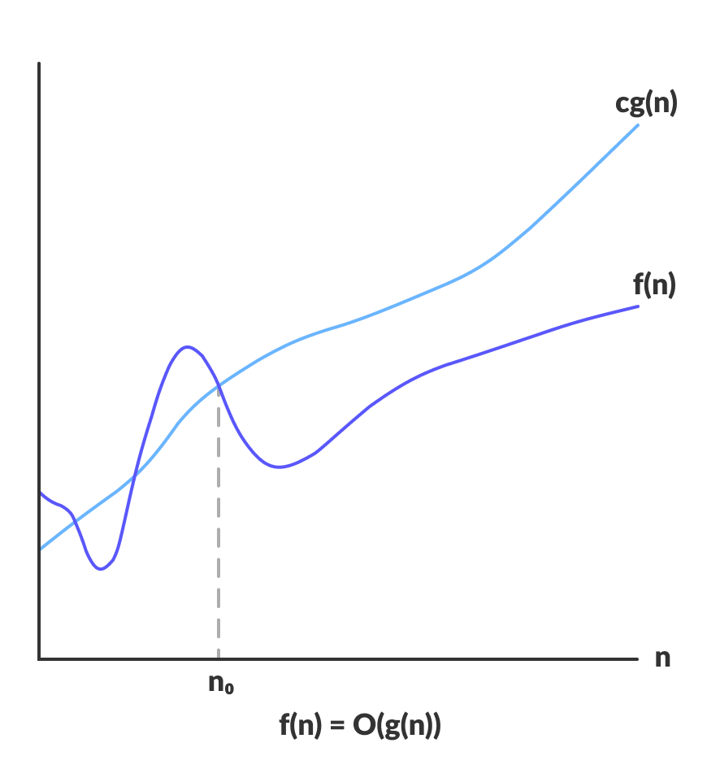
Big-O Notation (O-notation)
Big-O notation represents the upper bound of the running time of an algorithm. Thus, it gives the worst case complexity of an algorithm.
Definition:
f(n) = O(g(n)) if there exists a positive integer n₀ and a positive constant c, such that f(n)≤c *g(n) ∀ n≥n₀
The Big O notation defines an upper bound of an algorithm.
Big O notation is a notation used when talking about growth rates.

Slide 15
Example: 5n^2 + 3n + 4

Slide 16
The general step wise procedure for Big-O runtime analysis is as follows:
Find out what the input is and what n represents.
Express the maximum number of operations, the algorithm performs in terms of n.
Eliminate all excluding the highest order terms.
Remove all the constant factors.

Slide 17
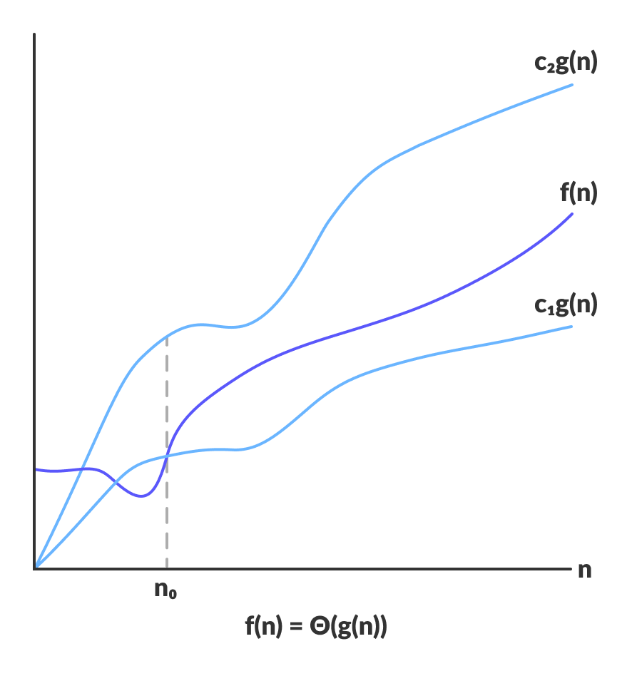
Theta Notation (Θ-notation)
Theta notation encloses the function from above and below. Since it represents the upper and the lower bound of the running time of an algorithm, it is used for analysing the average case complexity of an algorithm.
For a function g(n), Θ(g(n)) is given by the relation:
Definition: f(n) = Θ(g(n)) if there exists a positive integer n₀ and positive constants c1 & c2, such that 0<=c1*g(n)<=f(n)<=c2* g(n) ∀ n≥n₀

Slide 18
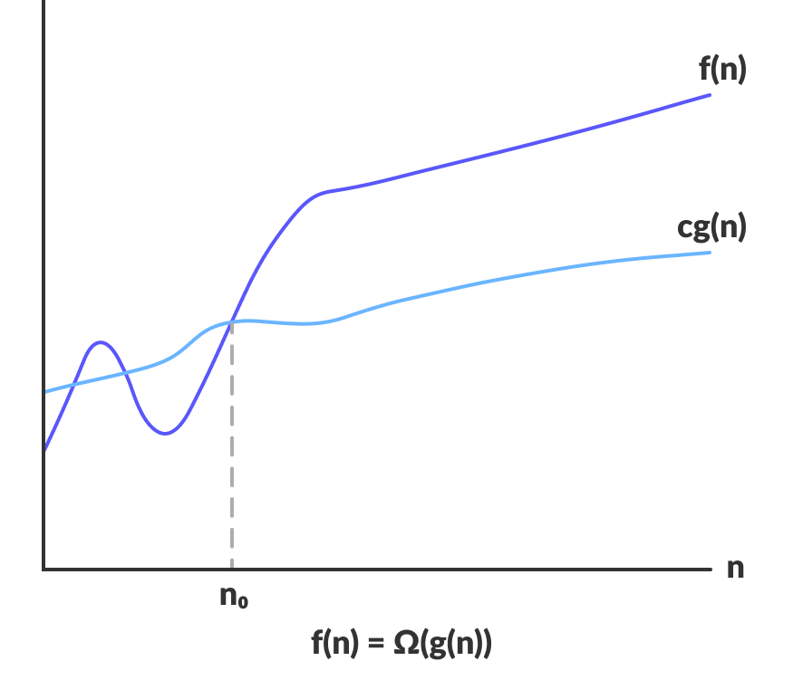
Omega Notation (Ω-notation)
Omega notation represents the lower bound of the running time of an algorithm. Thus, it provides best case complexity of an algorithm.
Definition: Ω(g(n)) = f(n): there exist positive constants c and n₀ such that
0 ≤ c * g(n) ≤ f(n) for all n ≥ n₀

Slide 19
Types of Complexities:
Constant Time Complexity O(1)
Linear Time Complexity O(n)
Logarithmic Time Complexity O(log n)
Log-Linear Time Complexity O(n log n)
Polynomial Time Complexity O(n^c)
Exponential Time Complexity O(c^n) (Ex: O(2^n)
Factorial Time Complexity O(n!)
Order of growth:-
O(1)<=O(log n) <= O( n) <= O(n log n) <= O(n^2) <= O(n^3) <= O(2^n) <= O(n!)

Slide 20
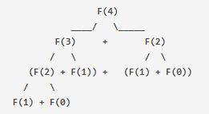
Exponential Time Complexity:
For example, following recursive code to find Nth fibonacci number has Time Complexity as O(2^N)
def F(n):
if n == 0:
return 0
elif n == 1:
return 1
else:
return F(n-1) + F(n-2) # For every call to F, we make 2 more calls to F itself

Slide 21
Polynomial Time Complexity:
When the computation time increases as function of N raised to some power, N being the size of input. Such a code has Polynomial Time Complexity.
For example, let’s say we have a list of size N and we have nested loops on that list.
for i in N:
for j in N:
# Some processing
In the above code, the processing part is executed N*N times i.e. N^2 times. Such a code has O(N^2) time complexity.

Slide 23
Linear Search:-
Worst-case performance | O(n)
Best-case performance | O(1)
Average performance | O(n)
Binary Search & Fibonacci Search:-
Worst-case performance | O(log n)
Best-case performance | O(1)
Average performance | O(log n)

